Slide 1
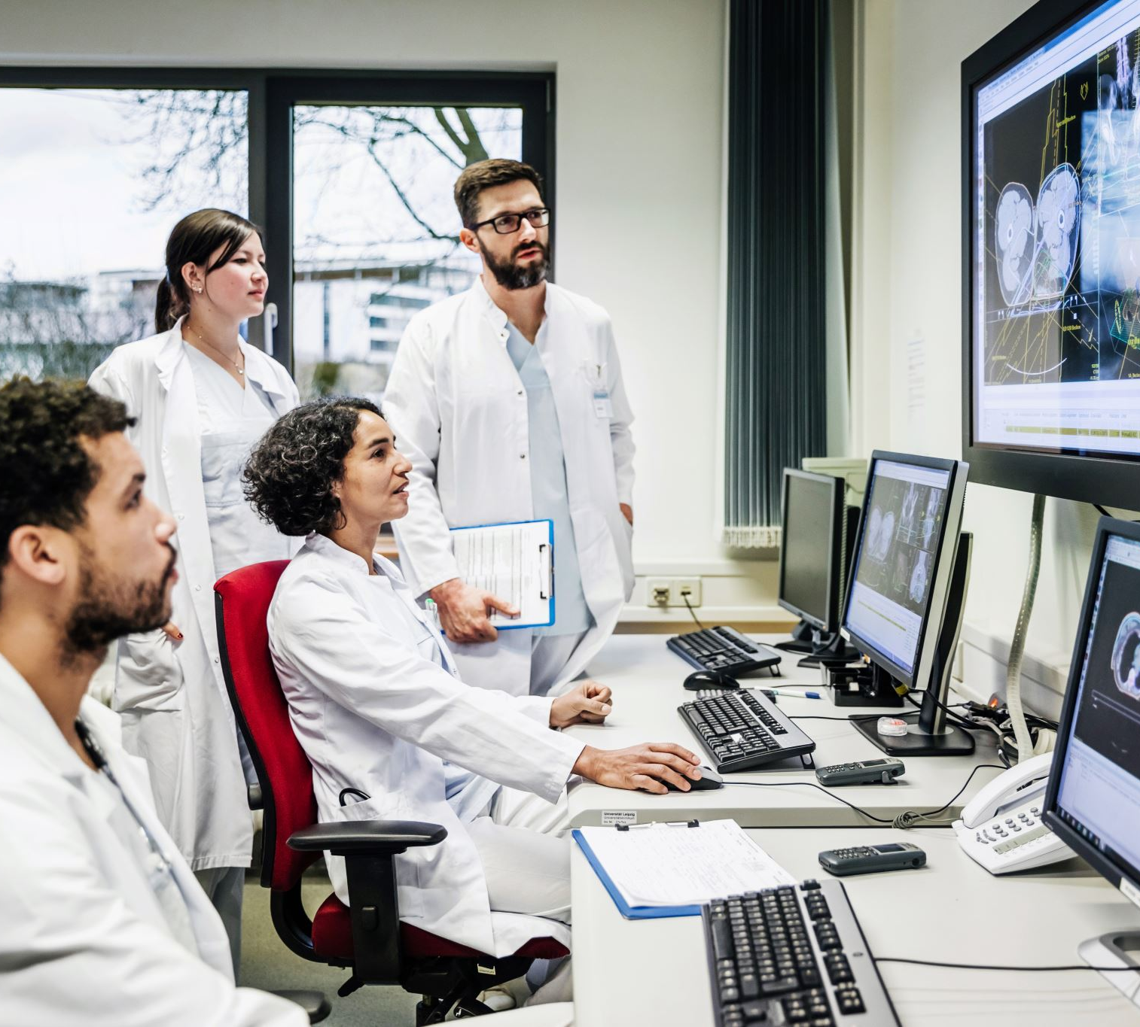

Utilization of AI tools

Slide 2

Utilization of AI tools
AI tools
Scikit-learn
Open CV
AutoML
Beautiful Soup
Google Cloud

Slide 3
Utilization of AI tools
AI tools
Scikit-learn
Open CV
AutoML
Beautiful Soup
Google Cloud

Slide 4
AI tools
Scikit-learn is a popular and user-friendly machine learning library in Python. It helps you build machine learning models without needing to write complex code from scratch. Scikit-learn has a simple and consistent interface, it provides a wide range of algorithms and helps you preprocess and clean your data
Scikit-learn
Open CV
AutoML
Beautiful Soup
Google Cloud

Slide 5
AI tools
AutoML, which stands for Automated Machine Learning, is a set of techniques and tools that automate the process of building and deploying machine learning models. The goal of AutoML is to reduce the manual effort required for model selection, hyperparameter tuning, feature engineering, and other repetitive tasks involved in the machine learning pipeline. It enables non-experts to harness the power of machine learning for various tasks without the need for in-depth knowledge of the underlying algorithms.
AutoML
Scikit-learn
Google Cloud
Open CV
Beautiful Soup

Slide 6
AI tools
Google Cloud is a cloud computing platform provided by Google, offering a suite of cloud-based services and tools for building, deploying, and scaling applications and managing data. It provides infrastructure, storage, machine learning, data analytics, and other services through a network of data centers worldwide.
Google Cloud
AutoML
Beautiful Soup
Scikit-learn
Open CV

Slide 7
AI tools
Beautiful Soup is a Python library for parsing structured data. It allows you to interact with HTML in a similar way to how you interact with a web page using developer tools.
Beautiful Soup
Google Cloud
Open CV
AutoML
Scikit-learn

Slide 8
AI tools
OpenCV (Open Source Computer Vision Library) is an open-source computer vision and machine learning software library. It provides a wide range of functionalities to perform various image and video processing tasks, including object detection, image recognition, camera calibration, and more
Open CV
Beautiful Soup
Scikit-learn
Google Cloud
AutoML

Slide 9
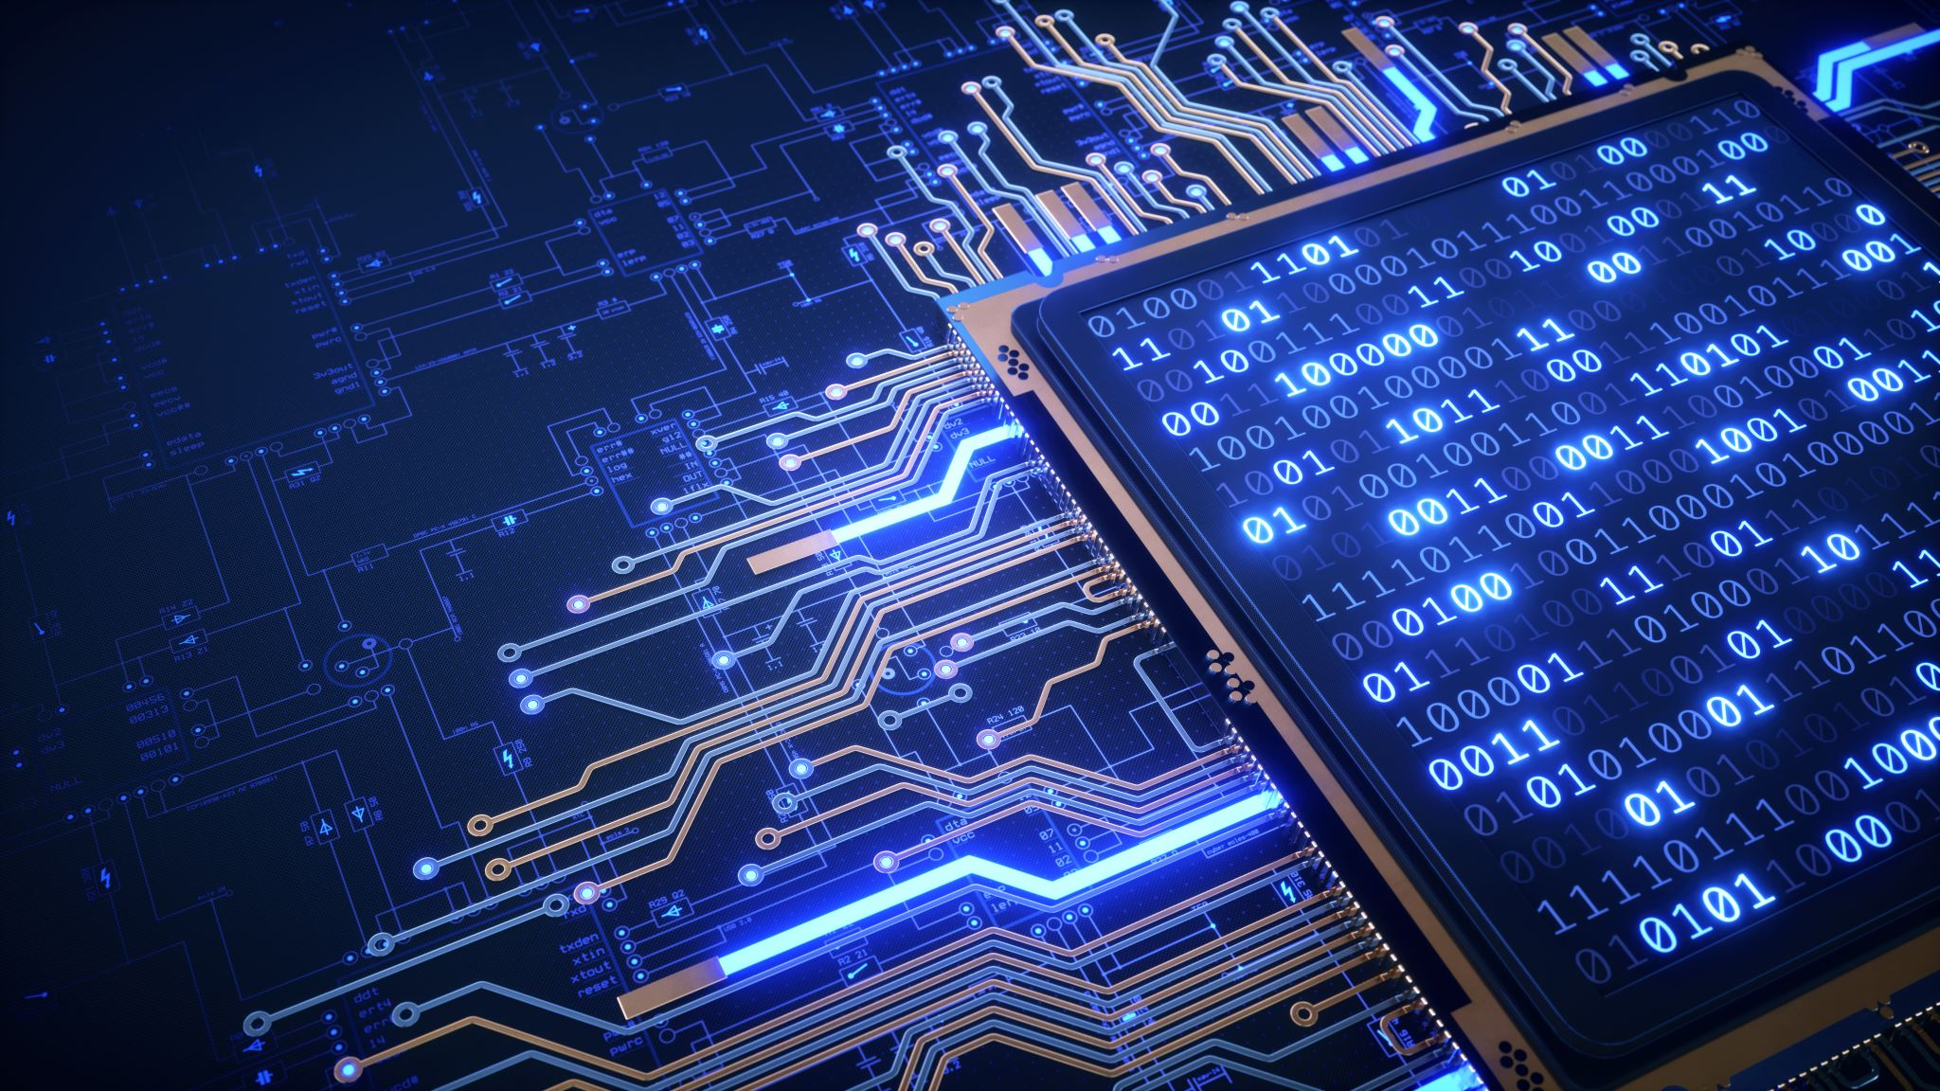
AI tools
AI tools
Scikit-learn
Open CV
AutoML
DeepL
QuillSEOTools
Beautiful Soup
Google Cloud
Jenni AI
Grammarly
Sci Summary
Tabula

Slide 10
AI tools
AI tools
DeepL
QuillSEOTools
Scikit-learn
Jenni AI
Grammarly
Open CV
AutoML
Sci Summary
Tabula
Beautiful Soup
Google Cloud

Slide 11
AI tools
QuillSEOTools
Grammarly
Tabula
Sci Summary
Jenni AI
DeepL
Slides by:- Akash L M

Slide 12
AI tools
QuillSEOTools
Grammarly
Tabula
Sci Summary
Jenni AI
DeepL
QuillSEOTools is used to check for plagiarism gratis sentence by sentence. Additionally, it was used to count the words in the article and to modify it. used to produce the MD5 generator and many other

Slide 13
AI tools
Grammarly
Tabula
Sci Summary
Jenni AI
DeepL
QuillSEOTools
Grammarly is a widely used online writing assistant tool that helps users enhance their writing by identifying and correcting grammar, spelling, punctuation, and style errors. It offers a browser extension, desktop app, and mobile keyboard integration, making it convenient for various writing contexts.
QuillSEOTools is used to check for plagiarism gratis sentence by sentence. Additionally, it was used to count the words in the article and to modify it. used to produce the MD5 generator and many other

Slide 14
AI tools
Tabula
Sci Summary
Jenni AI
DeepL
QuillSEOTools
Grammarly
Tabula is an open-source data extraction tool designed to extract tables from PDF documents and convert them into structured data formats, such as CSV (Comma-Separated Values) or Microsoft Excel spreadsheets.
Here's how Tabula is typically used:Import PDF: Users start by uploading or importing a PDF document into Tabula.
Grammarly is a widely used online writing assistant tool that helps users enhance their writing by identifying and correcting grammar, spelling, punctuation, and style errors. It offers a browser extension, desktop app, and mobile keyboard integration, making it convenient for various writing contexts.
QuillSEOTools is used to check for plagiarism gratis sentence by sentence. Additionally, it was used to count the words in the article and to modify it. used to produce the MD5 generator and many other

Slide 15
AI tools
Sci Summary
Jenni AI
DeepL
QuillSEOTools
Grammarly
Tabula
SciSummary uses GPT-3.5 and GPT-4 models to provide summaries of any scientific articles or research papers. The technology learns as it goes as our team of PhDs analyze requested summaries and guides the training of the model. SciSummary makes it easy to stay up-to-date with the latest scientific breakthroughs and research findings, without having to spend hours reading through long and complex articles.
Tabula is an open-source data extraction tool designed to extract tables from PDF documents and convert them into structured data formats, such as CSV (Comma-Separated Values) or Microsoft Excel spreadsheets.
Here's how Tabula is typically used:Import PDF: Users start by uploading or importing a PDF document into Tabula.
Grammarly is a widely used online writing assistant tool that helps users enhance their writing by identifying and correcting grammar, spelling, punctuation, and style errors. It offers a browser extension, desktop app, and mobile keyboard integration, making it convenient for various writing contexts.

Slide 16
AI tools
Jenni AI
DeepL
QuillSEOTools
Grammarly
Tabula
Sci Summary
Jenni AI used to generate sentences one at a time, but we could also choose alternate sentences, execute AI instructions, and export the paper.
SciSummary uses GPT-3.5 and GPT-4 models to provide summaries of any scientific articles or research papers. The technology learns as it goes as our team of PhDs analyze requested summaries and guides the training of the model. SciSummary makes it easy to stay up-to-date with the latest scientific breakthroughs and research findings, without having to spend hours reading through long and complex articles.
Tabula is an open-source data extraction tool designed to extract tables from PDF documents and convert them into structured data formats, such as CSV (Comma-Separated Values) or Microsoft Excel spreadsheets.
Here's how Tabula is typically used:Import PDF: Users start by uploading or importing a PDF document into Tabula.

Slide 17
AI tools
DeepL
QuillSEOTools
Grammarly
Tabula
Sci Summary
Jenni AI
DeepL is a machine translation service that employs deep learning techniques to provide accurate and high-quality translations across multiple languages. It uses neural networks and advanced algorithms to understand the context and nuances of the input text, resulting in translations that often rival or surpass those produced by other machine translation services.
Jenni AI used to generate sentences one at a time, but we could also choose alternate sentences, execute AI instructions, and export the paper.
SciSummary uses GPT-3.5 and GPT-4 models to provide summaries of any scientific articles or research papers. The technology learns as it goes as our team of PhDs analyze requested summaries and guides the training of the model. SciSummary makes it easy to stay up-to-date with the latest scientific breakthroughs and research findings, without having to spend hours reading through long and complex articles.

Slide 18
AI tools
QuillSEOTools
Grammarly
Tabula
Sci Summary
Jenni AI
DeepL
DeepL is a machine translation service that employs deep learning techniques to provide accurate and high-quality translations across multiple languages. It uses neural networks and advanced algorithms to understand the context and nuances of the input text, resulting in translations that often rival or surpass those produced by other machine translation services.
Jenni AI used to generate sentences one at a time, but we could also choose alternate sentences, execute AI instructions, and export the paper.

Slide 19
AI tools
QuillSEOTools
Grammarly
Tabula
Sci Summary
Jenni AI
DeepL
DeepL is a machine translation service that employs deep learning techniques to provide accurate and high-quality translations across multiple languages. It uses neural networks and advanced algorithms to understand the context and nuances of the input text, resulting in translations that often rival or surpass those produced by other machine translation services.

Slide 20
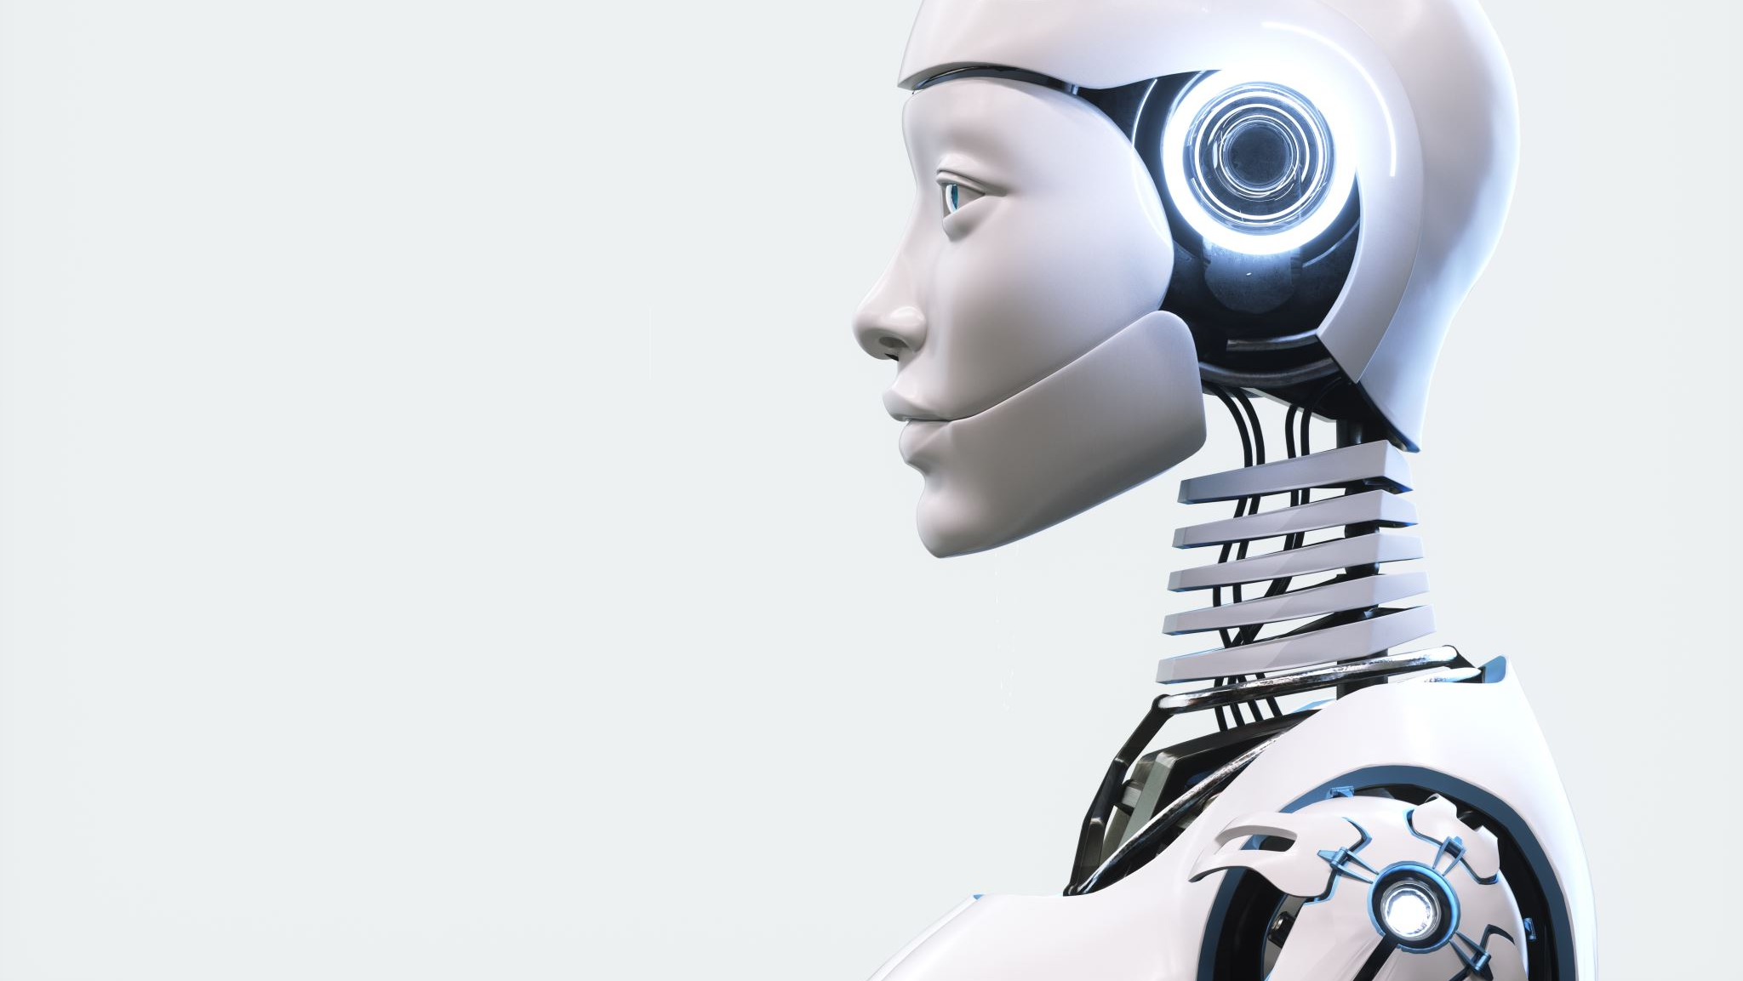
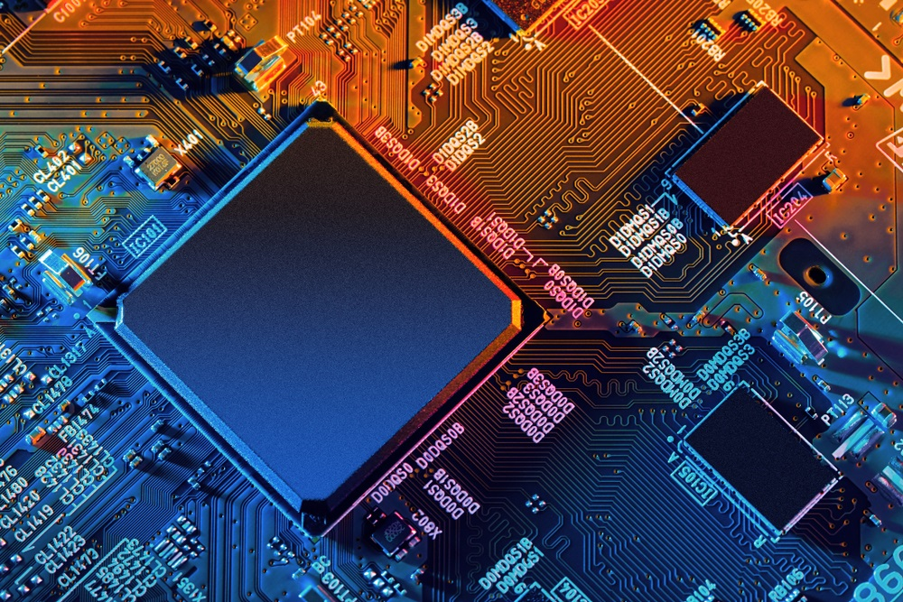

Q&A Sessions
Thank you
From:-
Nidec Team

Slide 21
Q&A Sessions
Thank you
From:-
Nidec Team

